Slide 1
The Authentication Equation Visualizing the convergence of security and usability of text-based passwords
Cathryn Ploehn, Kristen Greene
United States National Institute of Standards and Technology

Slide 2
Disclaimer:
Any mention of commercial products or reference to commercial organizations is for information only; it does not imply recommendation or endorsement by the National Institute of Standards and Technology nor does it imply that the products mentioned are necessarily the best available for the purpose.

Slide 3
a universal struggle of the modern human

Slide 4
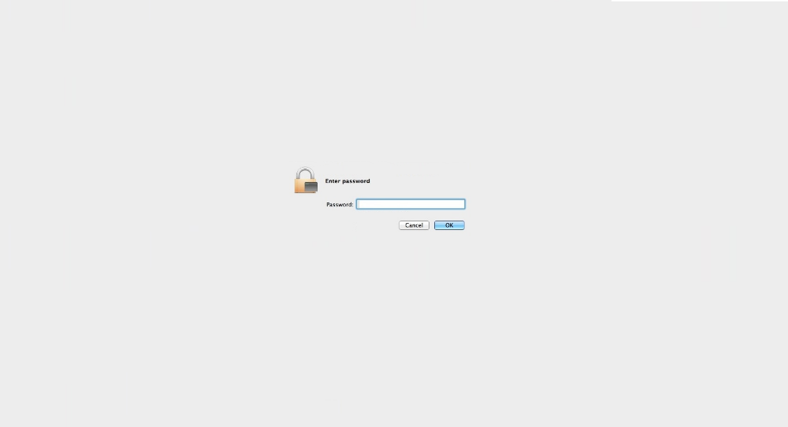
Notes:
Text based authentication

Slide 5
text-based passwords
Lacking in usability
Winning in longevity

Slide 6
text-based passwords
Super secure
super secure?
Managed by unusable (but secure) requirements

Slide 7
text-based passwords
Managed by unusable (but secure) requirements,
which cause mental strain

Slide 8
0Vi:cxsyn03'An

Slide 9
0Vi:cxsyn03'An

Slide 10
Do I exist?
security
usability

Slide 11
Can we optimize password requirements for usability?
(while maintaining the security)

Slide 12
Identify which aspects of secure passwords lead to usability failures

Slide 13
Number of symbols
0Vi:cxsyn03'An
Number of digits
length

Slide 14
Explore the interaction between security and usability components of passwords

Slide 15
":MD}X,3r+v",1,3,0,1,0,0,5,65.54588851677637,"MDXrv3:},+",51.92475240350173,13.621136113274641,20.781068685625232,0,3,2,1,0,0,6,23,17,23,17,16,16,10,5,1,4
{Pfu_7P5>i,1,1,2,0,1,-1,4,65.54588851677637,PPfui75{_>,50.92475240350173,14.621136113274641,22.306717391636827,0,1,3,1,0,-1,4,22,14,22,14,15,15,10,5,2,3
"^,:Ll4~2R^",1,5,1,0,0,0,7,65.54588851677637,"LRl42^,:~^",52.661717997667935,12.884170519108435,19.656718080510498,0,5,2,1,0,0,8,22,16,19,15,16,16,10,3,2,5
3wA5~wfyRe,0,0,2,2,1,-2,3,65.54588851677637,ARwwfye35~,52.661717997667935,12.884170519108435,19.656718080510498,0,0,4,1,0,-1,4,17,14,17,14,13,13,10,7,2,1
"r};1:=Z,Nb",0,7,0,0,0,0,7,65.54588851677637,"ZNrb1};:=,",52.661717997667935,12.884170519108435,19.656718080510498,0,5,2,1,0,0,8,19,17,19,17,14,14,10,4,1,5
st<gOfZ@&8,0,3,1,1,0,-1,4,65.54588851677637,OZstgf8<@&,51.92475240350173,13.621136113274641,20.781068685625232,0,1,3,1,0,-1,4,16,15,16,15,15,15,10,6,1,3
dJ}5GRA8pj,0,0,2,2,1,-1,4,65.54588851677637,JGRAdpj58},51.92475240350173,13.621136113274641,20.781068685625232,0,0,4,1,0,-1,4,20,16,20,16,15,15,10,7,2,1
",)1i*ZNq;U",1,3,1,1,0,0,6,65.54588851677637,"ZNUiq1,)*;",51.92475240350173,13.621136113274641,20.781068685625232,0,3,2,1,0,-1,5,20,16,19,14,15,15,10,5,1,4
i&#8Zw$NS$,0,3,1,1,0,0,5,65.54588851677637,ZNSiw8&#$$,51.92475240350173,13.621136113274641,20.781068685625232,0,3,2,1,0,-1,5,20,16,20,16,17,17,10,5,1,4
h|v+wzDA3N,0,1,2,1,1,-1,4,65.54588851677637,DANhvwz3|+,51.92475240350173,13.621136113274641,20.781068685625232,0,0,3,1,0,-1,3,21,15,21,15,15,15,10,7,1,2
!0vG.bvc@h,1,1,2,1,0,0,5,65.54588851677637,Gvbvch0!.@,53.2466804983891,12.29920801838728,18.76427079821996,0,1,3,0,0,0,4,17,12,17,12,13,13,10,6,1,3
qw|43#UHbh,0,1,1,1,0,-1,2,65.54588851677637,UHqwbh43|#,51.33978990278057,14.206098613995799,21.673515967915773,0,0,3,1,0,-1,3,17,14,17,14,14,14,10,6,2,2
tw|850|_iB,0,3,1,1,0,-1,4,65.54588851677637,Btwi850||_,51.50971490422289,14.036173612553485,21.41427010934629,0,1,3,0,0,-1,3,16,13,16,13,14,14,10,4,3,3
4]I]i~L4Kn,0,3,1,0,1,0,5,65.54588851677637,ILKin44]]~,50.92475240350173,14.621136113274641,22.306717391636827,0,1,3,1,0,-1,4,24,15,24,15,14,14,10,5,2,3
!l:z3LM%8M,1,1,1,1,1,0,5,65.54588851677637,LMMlz38!:%,50.92475240350173,14.621136113274641,22.306717391636827,0,1,3,1,0,0,5,23,15,23,15,16,16,10,5,2,3
wEqC)8gdwl,0,0,2,1,0,-1,2,65.54588851677637,ECwqgdwl8),54.2466804983891,11.29920801838728,17.238622092208367,0,0,4,1,0,-1,4,14,13,14,13,13,13,10,8,1,1
?<o2$YE}jQ,1,3,0,2,0,-1,5,65.54588851677637,YEQoj2?<$},51.92475240350173,13.621136113274641,20.781068685625232,0,3,2,1,0,-1,5,21,17,21,17,17,17,10,5,1,4
m{&n3S5G2s,0,1,2,0,1,0,4,65.54588851677637,SGmns352{&,50.92475240350173,14.621136113274641,22.306717391636827,0,0,3,1,0,0,4,22,15,22,15,14,14,10,5,3,2
[35<TuIqvq,1,0,2,1,0,-1,3,65.54588851677637,TIuqvq35[<,51.33978990278057,14.206098613995799,21.673515967915773,0,0,3,1,0,-1,3,17,14,17,14,13,13,10,6,2,2
"yyY,wbDZ0@",0,0,3,2,0,-1,4,65.54588851677637,"YDZyywb0,@",51.92475240350173,13.621136113274641,20.781068685625232,0,0,3,1,0,-1,3,16,14,16,14,14,14,10,7,1,2
"1,(*sT*zWx",0,5,0,2,0,0,7,65.54588851677637,"TWszx1,(**",51.92475240350173,13.621136113274641,20.781068685625232,0,3,2,1,0,0,6,18,14,16,13,15,15,10,5,1,4
!4UH>t6L<K,1,1,2,1,1,-1,5,65.54588851677637,UHLKt46!><,51.92475240350173,13.621136113274641,20.781068685625232,0,1,3,1,0,-1,4,24,16,24,16,17,17,10,5,2,3
dLZx{s$1i:,0,1,1,1,0,0,3,65.54588851677637,LZdxsi1{$:,51.92475240350173,13.621136113274641,20.781068685625232,0,1,3,1,0,-1,4,18,15,18,15,15,15,10,6,1,3
;5NemelGX8,1,0,4,1,1,-1,6,65.54588851677637,NGXemel58;,51.92475240350173,13.621136113274641,20.781068685625232,0,0,4,1,0,-1,4,16,14,16,14,13,13,10,7,2,1
"i7#op,N2c6",0,1,1,0,1,-1,2,65.54588851677637,"Niopc726#,",51.92475240350173,13.621136113274641,20.781068685625232,0,0,3,0,0,-1,2,19,14,19,14,12,12,10,5,3,2
t-pg8ceMUs,0,0,3,1,1,-1,4,65.54588851677637,MUtpgces8-,54.2466804983891,11.29920801838728,17.238622092208367,0,0,4,1,0,-1,4,16,13,16,13,12,12,10,8,1,1
j;W7<=p*lq,0,5,0,0,0,0,5,65.54588851677637,Wjplq7;<=*,52.92475240350173,12.621136113274641,19.25541997961364,0,3,2,0,0,0,5,19,13,18,14,13,13,10,5,1,4
:r6Sa/t*|&,1,5,1,0,1,-1,7,65.54588851677637,Srat6:/*|&,53.2466804983891,12.29920801838728,18.76427079821996,0,5,2,0,0,-1,6,20,14,20,14,15,15,10,4,1,5
1$Z?=LK(Eo,0,5,0,1,0,0,6,65.54588851677637,ZLKEo1$?=(,52.92475240350173,12.621136113274641,19.25541997961364,0,3,2,1,0,-1,5,21,17,21,17,17,17,10,5,1,4
wu*QjE{u{3,0,3,1,1,0,-2,3,65.54588851677637,QEwuju3*{{,51.92475240350173,13.621136113274641,20.781068685625232,0,1,3,1,0,-1,4,21,14,20,14,15,15,10,6,1,3
0&BvcTBJua,0,0,3,1,0,-1,3,65.54588851677637,BTBJvcua0&,52.92475240350173,12.621136113274641,19.25541997961364,0,0,4,1,0,0,5,16,15,16,15,15,15,10,8,1,1
%@5B{0bNHL,1,1,2,1,0,0,5,65.54588851677637,BNHLb50%@{,51.92475240350173,13.621136113274641,20.781068685625232,0,1,3,1,0,0,5,22,18,22,18,17,17,10,5,2,3
oPML~G}O8g,0,1,1,1,1,-1,3,65.54588851677637,PMLGOog8~},52.661717997667935,12.884170519108435,19.656718080510498,0,0,3,1,0,-1,3,23,17,23,17,17,17,10,7,1,2
"7o{,%~hM6D",0,5,1,1,1,-1,7,65.54588851677637,"MDoh76{,%~",51.33978990278057,14.206098613995799,21.673515967915773,0,3,2,1,0,-1,5,21,16,21,16,15,15,10,4,2,4
^d)6JgD:N8,1,1,1,1,0,0,4,65.54588851677637,JDNdg68^):,50.92475240350173,14.621136113274641,22.306717391636827,0,1,3,1,0,0,5,21,16,20,14,16,16,10,5,2,3
b5SAY8V7n$,0,0,4,1,1,-1,5,65.54588851677637,SAYVbn587$,51.92475240350173,13.621136113274641,20.781068685625232,0,0,4,1,0,-1,4,21,15,21,15,15,15,10,6,3,1
j;LqL8GHN8,0,0,3,1,1,0,5,65.54588851677637,LLGHNjq88;,52.661717997667935,12.884170519108435,19.656718080510498,0,0,4,1,0,0,5,20,16,20,16,15,15,10,7,2,1
&G};a+5.}Z,1,7,0,0,0,0,8,65.54588851677637,GZa5&};+.},54.2466804983891,11.29920801838728,17.238622092208367,0,7,1,1,0,-1,8,23,18,23,18,16,16,10,3,1,6
^S9ha|[c&a,1,3,1,0,1,-1,5,65.54588851677637,Shaca9^|[&,52.92475240350173,12.621136113274641,19.25541997961364,0,3,2,0,0,-1,4,21,14,20,14,14,14,10,5,1,4
8Y*sAm>H[l,0,3,1,1,0,-1,4,65.54588851677637,YAHsml8*>[,51.50971490422289,14.036173612553485,21.41427010934629,0,1,3,1,0,-1,4,24,15,23,15,15,15,10,6,1,3
gN2b[7K(Al,0,1,1,1,1,-1,3,65.54588851677637,NKAgbl27[(,50.92475240350173,14.621136113274641,22.306717391636827,0,0,3,1,0,-1,3,21,16,21,16,14,14,10,6,2,2
}GdB.J/2pJ,1,1,2,2,0,0,6,65.54588851677637,GBJJdp2}./,51.92475240350173,13.621136113274641,20.781068685625232,0,1,3,1,0,0,5,21,17,21,17,15,15,10,6,1,3

Slide 17
visualization tool to explore usability and security password metrics

Slide 18
Goals of the tool
support password usability research activities
enable the exploration of where password security and usability collide
share with research community as an open source tool

Slide 19
Tool composition
-------------- -----
--------
-----------------
-------------- -----
--------
-----------------
------
Password metric computation
Python3 code, run from terminal
Password metric visualization
Browser, D3.js

Slide 20
What we’ll cover
Identifying password metrics
Building the tool
Walkthrough
Lessons learned

Slide 21
1
Identifying
password metrics

Slide 22
task: automate computation of password metrics

Slide 23
metrics

Slide 24
Entropy
Uncertainty in a random variable, commonly used to measure theoretical password strength
Has limitations
**Line used as an example – does not reflect real data

Slide 25
Linguistic and phonological difficulty
Similarity of password to natural language.

Slide 26
How pronounceable is a password?

Slide 27
Number of keystrokes
Number of keystrokes to enter a password in
desktop, android, and iOS devices.

Slide 28
Password permutation
Rearrange passwords by character type to decrease keystrokes needed to enter on mobile devices

Slide 29
Password permutation
Original password
9#@z$tgH
Permuted password
Hztg9#@$

Slide 30
Outcome: code to produce metrics for a list of passwords

Slide 31
data
Original password
9#@z$tgH
Permuted password
Hztg9#@$

Slide 32
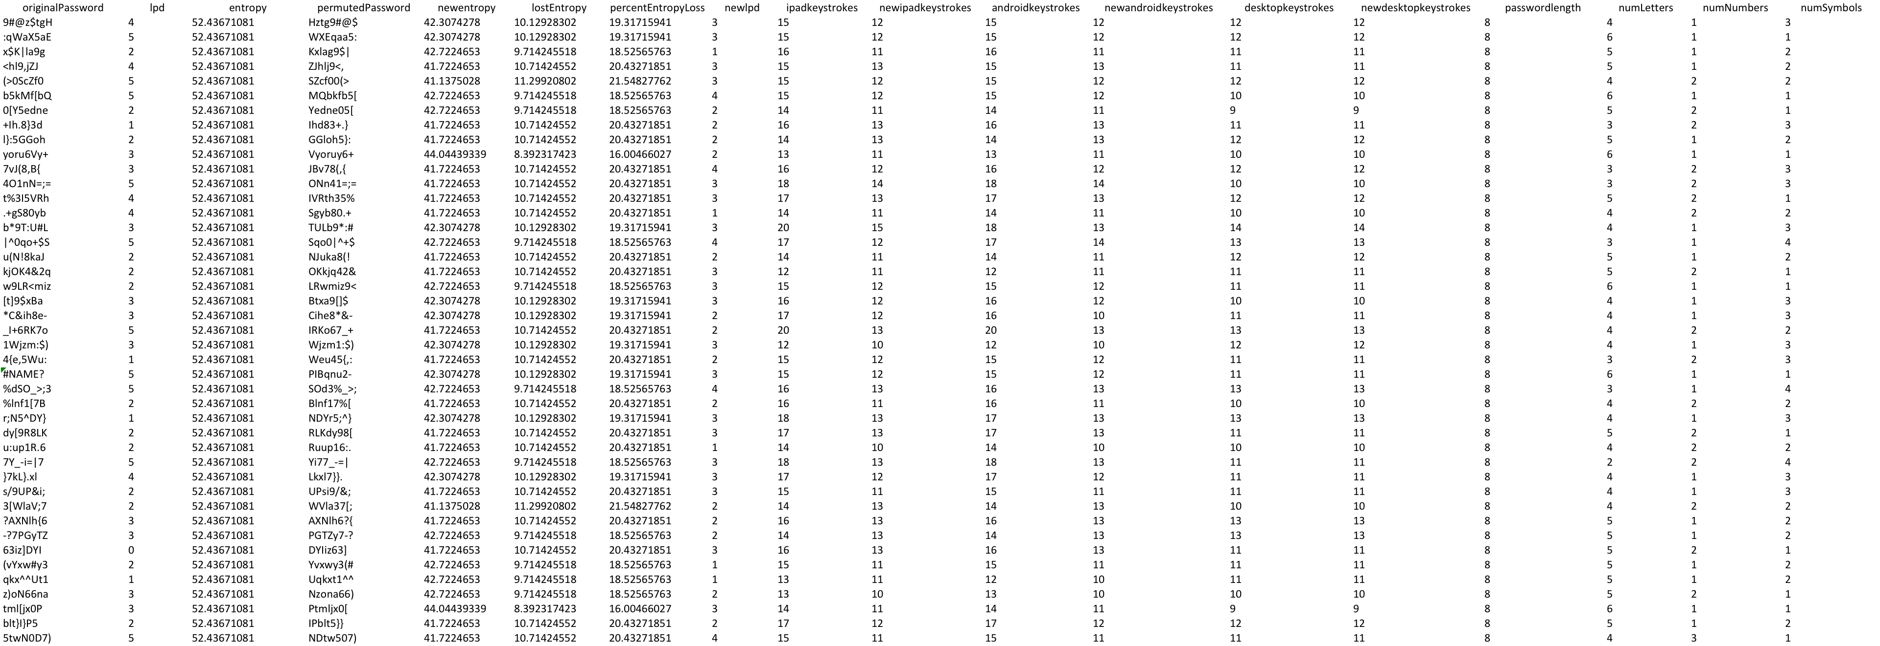
data

Slide 33
How can we view and interact with the data?

Slide 34
Identifying password metrics
Building the tool
Walkthrough
Lessons learned

Slide 35
2
Building a password
visualization tool

Slide 37
Design goals
Scalability
Tiers of granularity
Side by side comparison
Interactivity

Slide 38
visualization in the browser
Available, flexible, interactive

Slide 39
visualization in the browser
HTML, CSS, JavaScript

Slide 40
D3.js

Slide 41
Heatmap
higher value
lower value

Slide 42
Heatmap
Original password metrics
Permuted password metrics

Slide 43
Heatmap
Original password metrics
Permuted password metrics
New desktop keystrokes
New Android keystrokes
Desktop keystrokes
Android keystrokes
New iOS keystrokes
iOS keystrokes
New entropy
entropy
New LPD
LPD

Slide 44
Scalability
Works for ten, one hundred, one thousand passwords

Slide 45
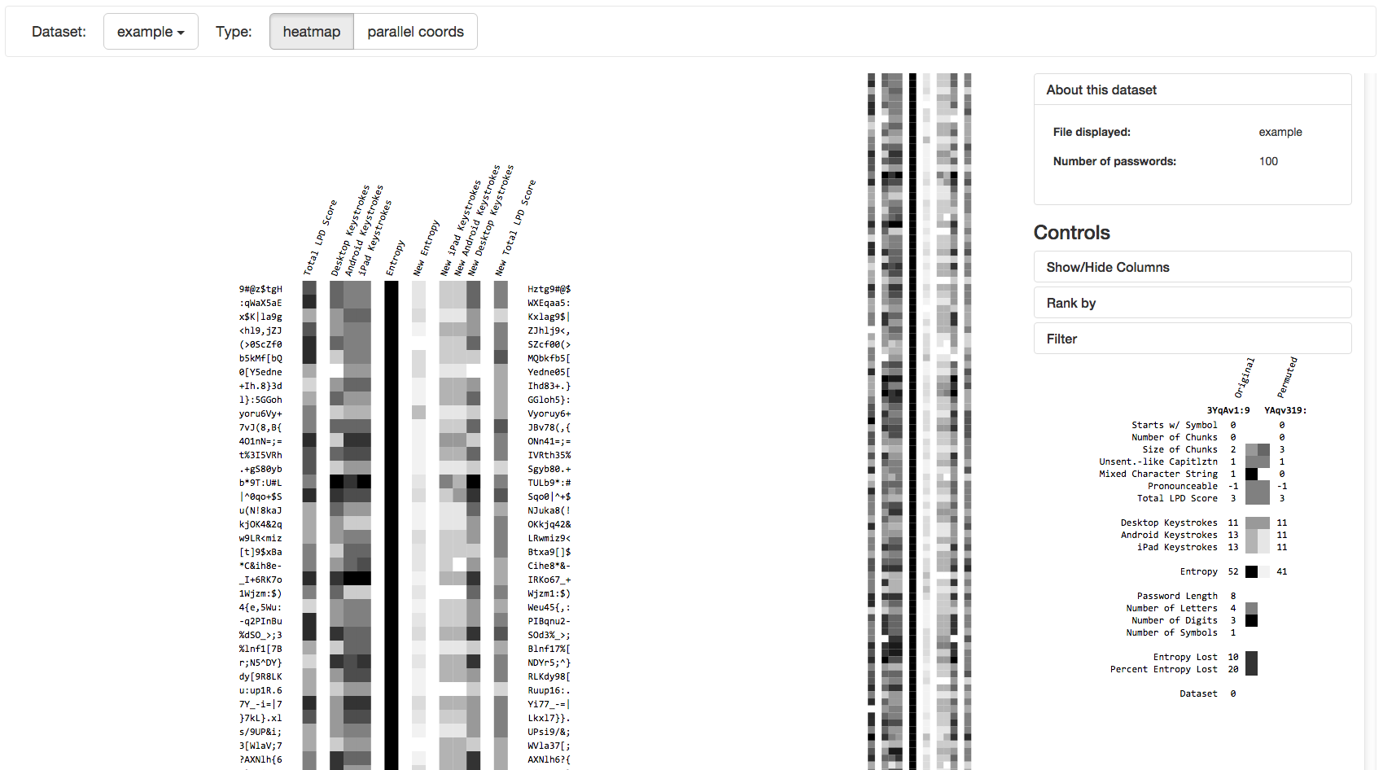
Tiers of granularity
Overview first, then details on demand

Slide 46
Tiers of granularity
Overview first, then details on demand

Slide 47
Tiers of granularity
Overview first, then details on demand

Slide 48
Side by side comparison
Compare passwords with their
permuted counterparts

Slide 49
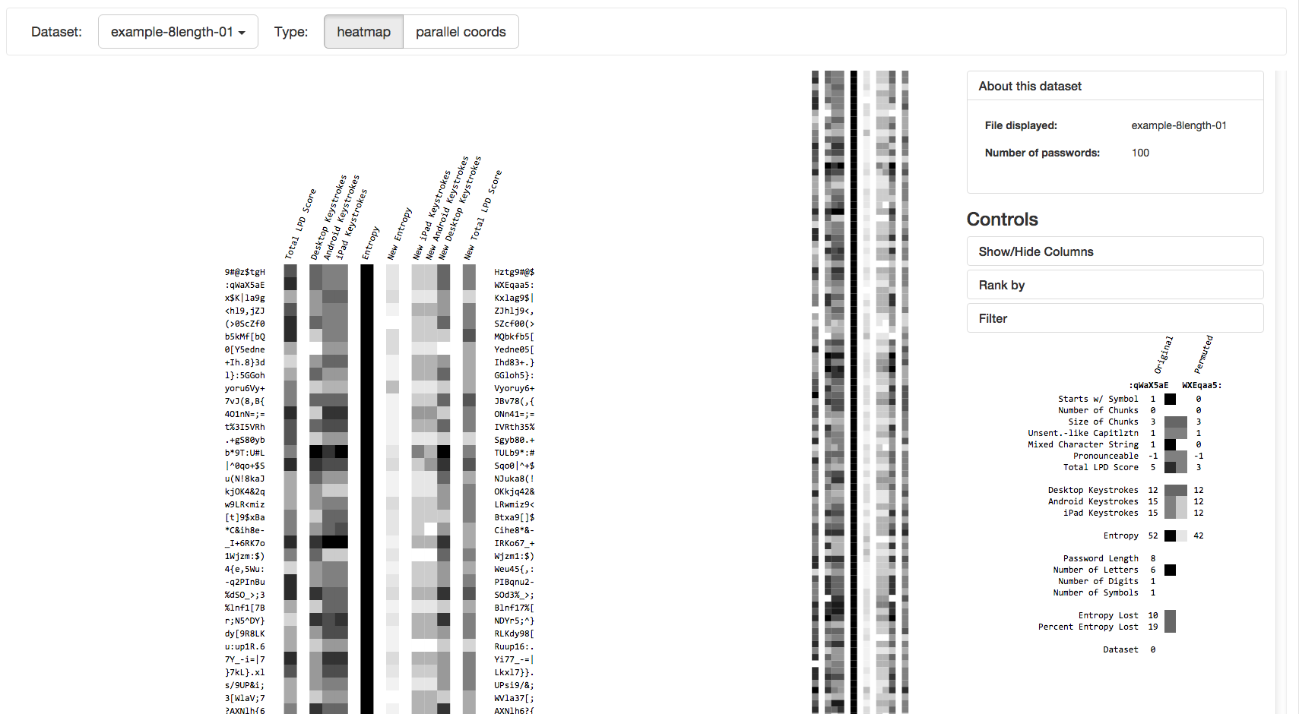
Interactivity
Filter, sort, etc.

Slide 50
Interactivity
Hide columns

Slide 51
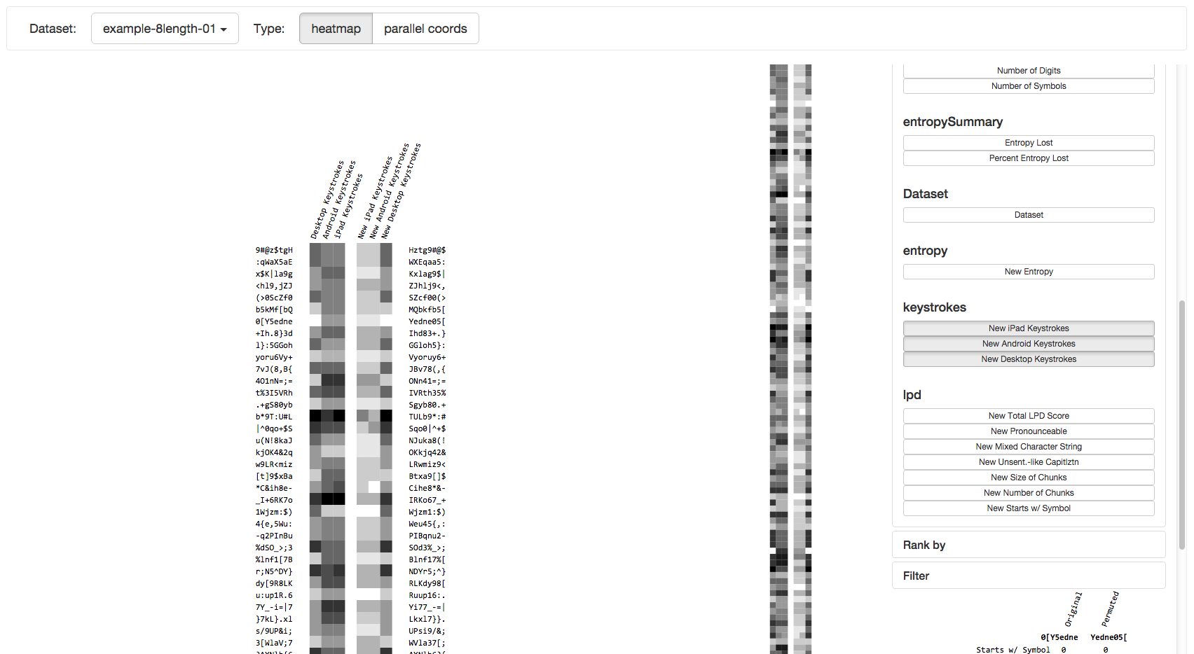
Interactivity
Hide columns

Slide 52
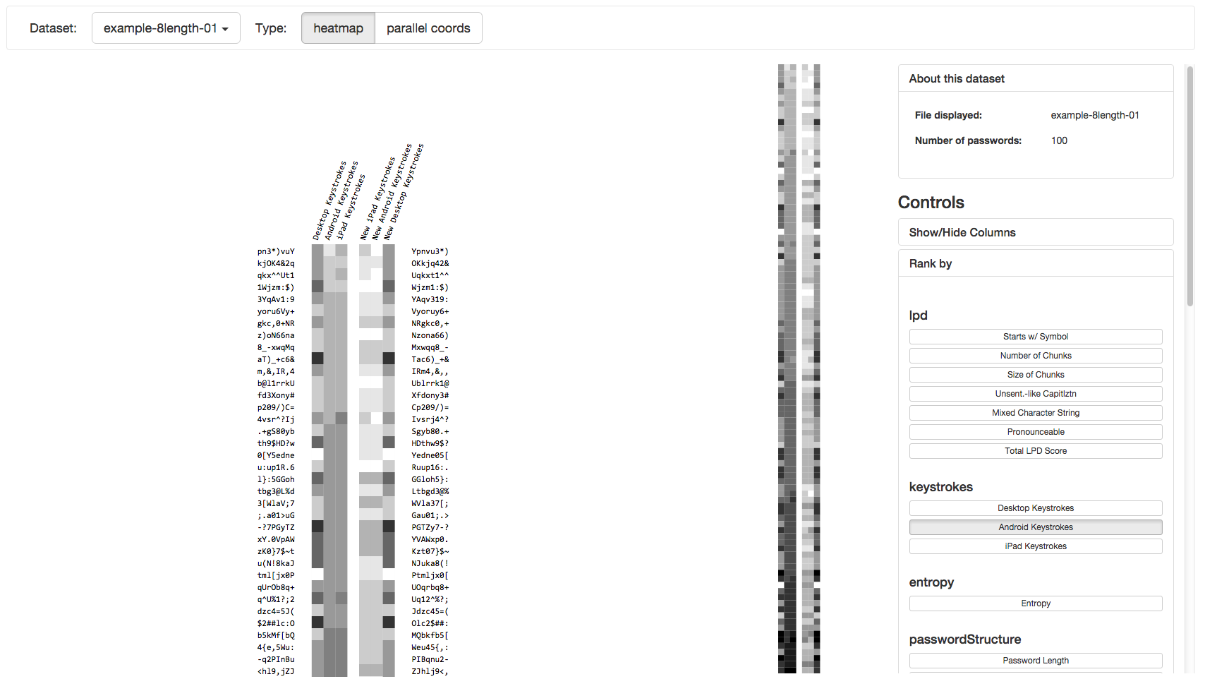
Interactivity
Sort rows

Slide 53
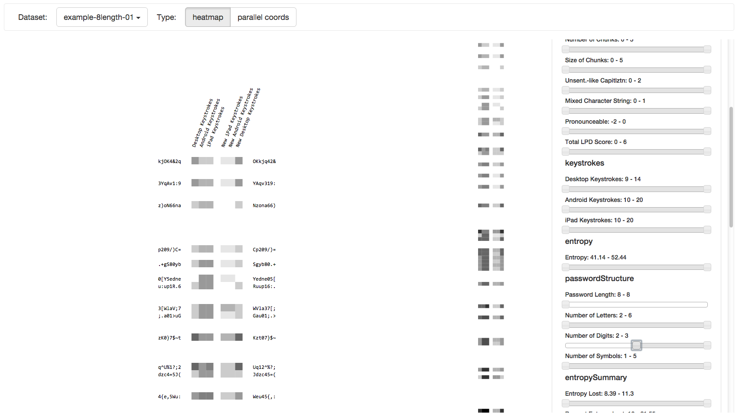
Interactivity
Filter rows

Slide 55
Limitations
Number of passwords viewable still low
Relationships hard to view
Can’t compare multiple datasets

Slide 56
Limitations
Code organization
Usability
Requires hard coding
GUI could do more

Slide 57
Tool improvements
More visualization paradigms
Compare multiple datasets
GUI improvements
Restructure code

Slide 58
Parallel coordinates
Common way of analyzing multivariate data

Slide 59
Parallel coordinates
Increase the number of passwords capable of being rendered

Slide 60
Parallel coordinates
Makes relationships between variables more apparent

Slide 61
< canvas >
Render larger datasets by queuing data to be rendered

Slide 63
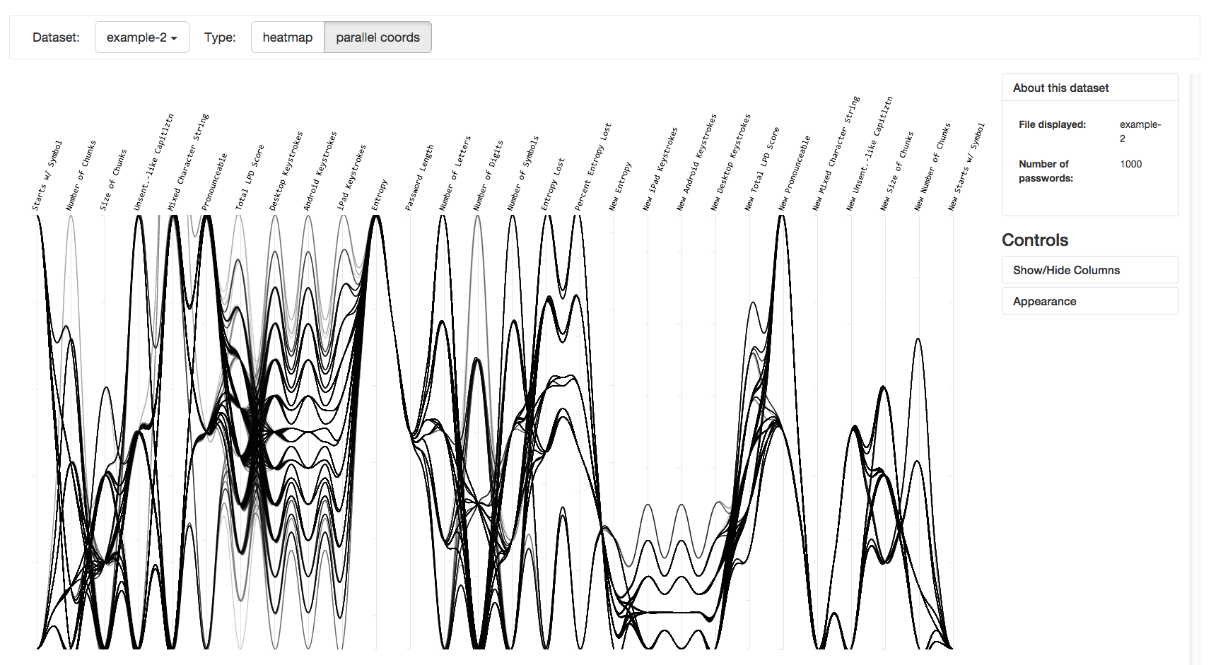
Scalability
Works for 1000+ passwords

Slide 64
Side by side comparison
Compare passwords with their permuted counterparts

Slide 65
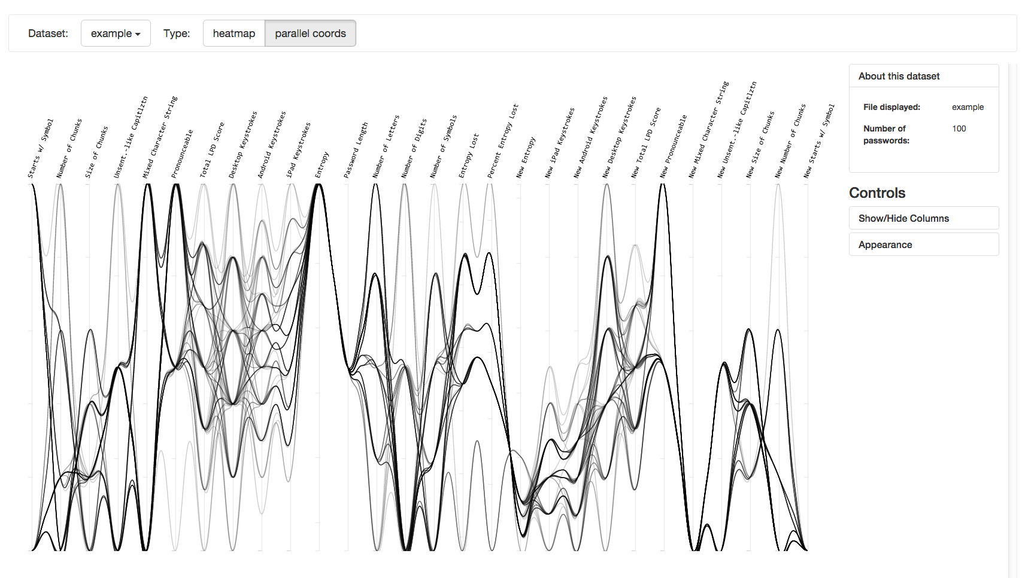
Interactivity
Filter, sort, etc.

Slide 66
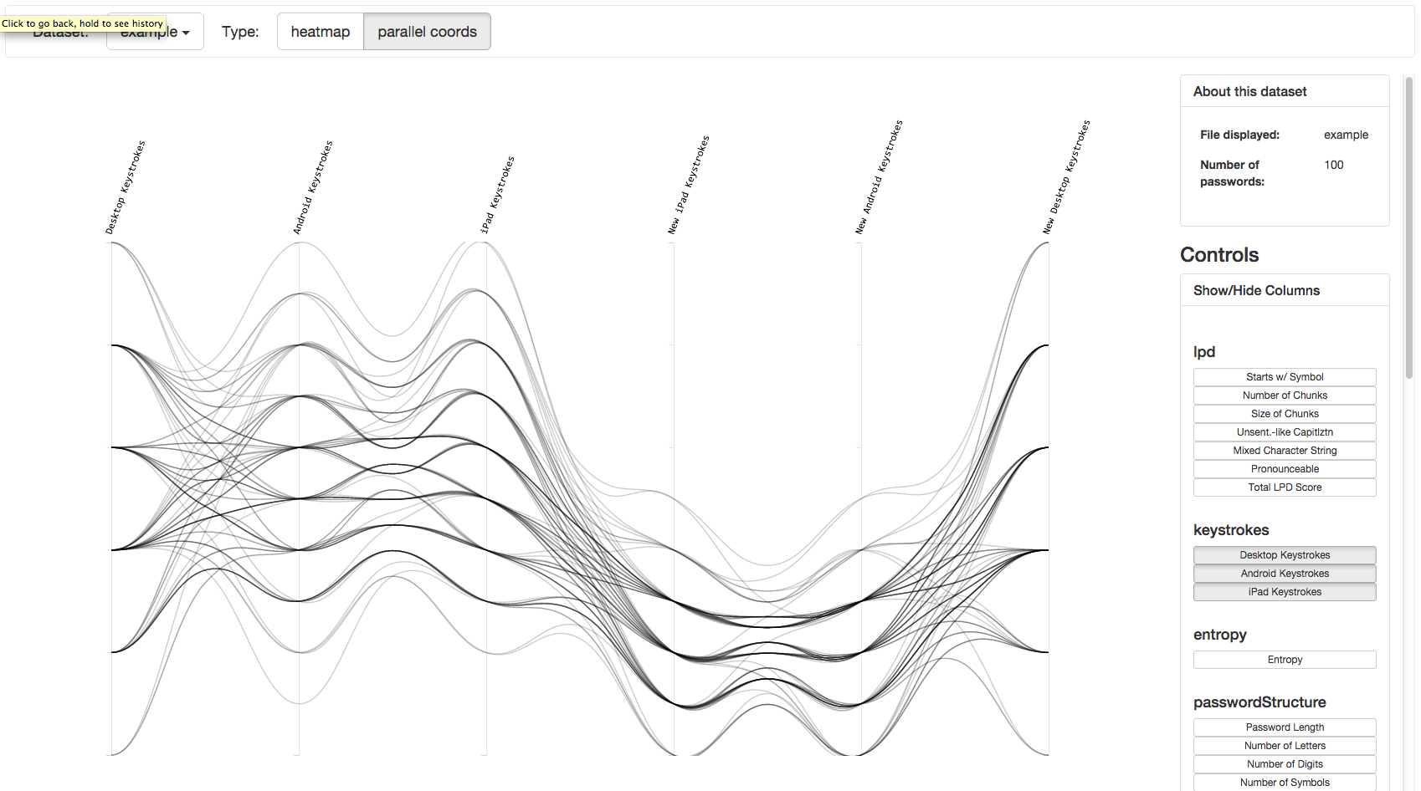
Hide columns

Slide 67
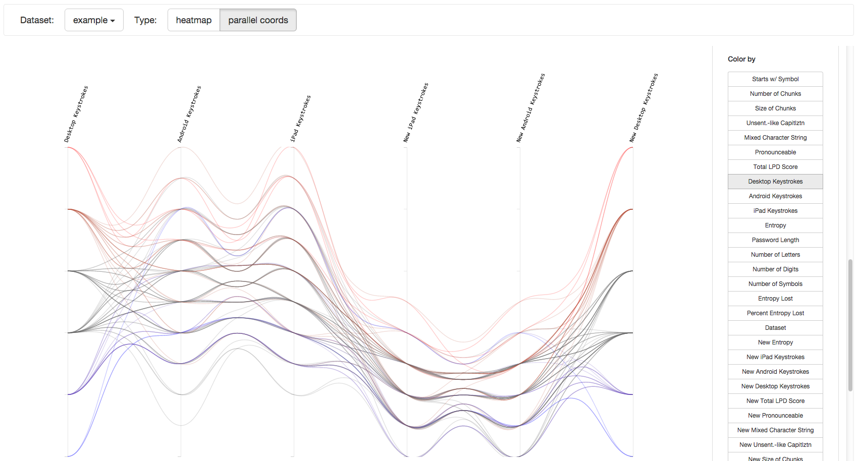
Change line coloring

Slide 68
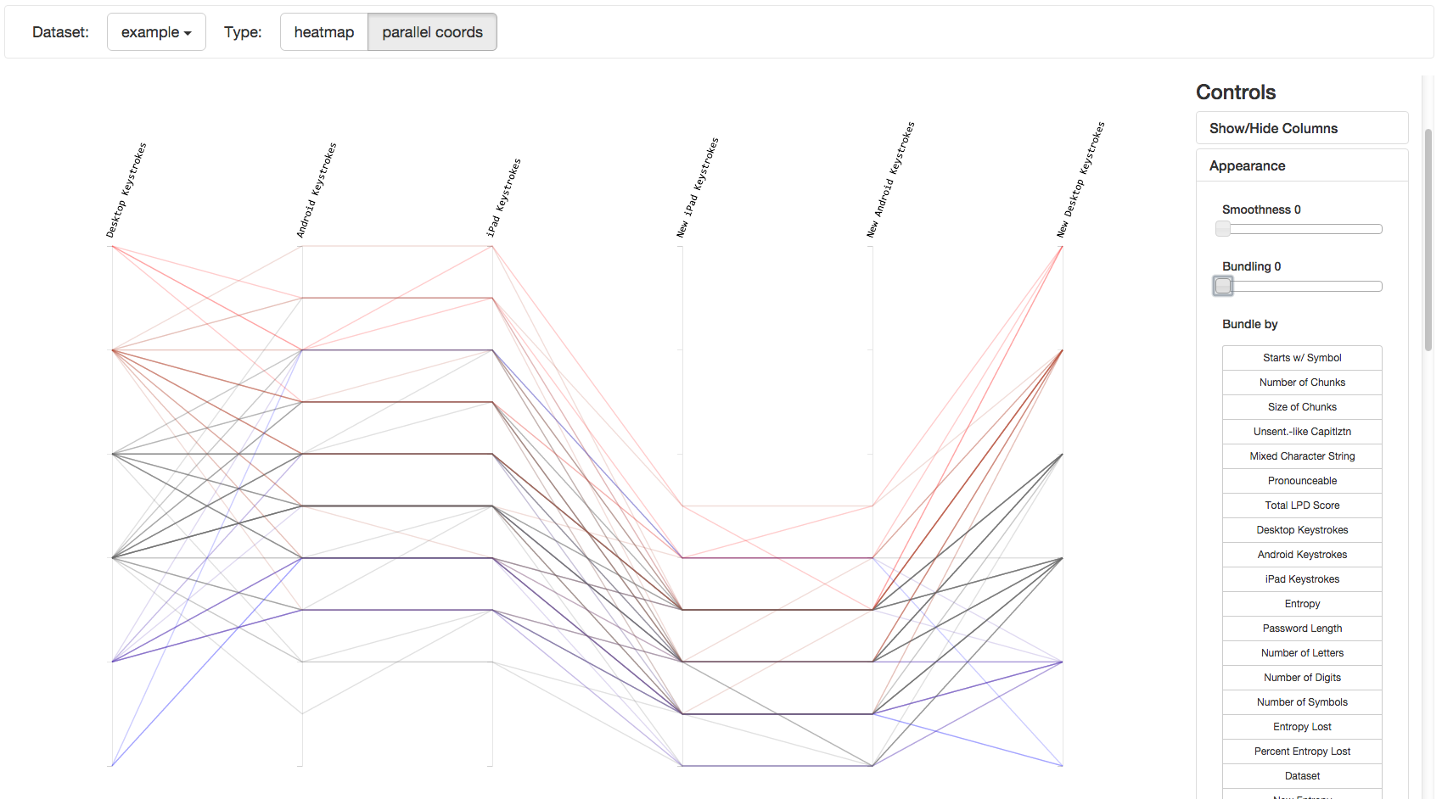
Change line
bundling & smoothness

Slide 69
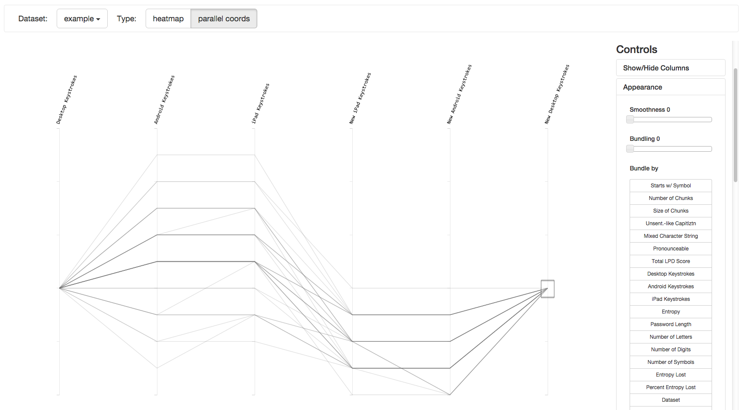
Brushing

Slide 70
Compare datasets

Slide 71
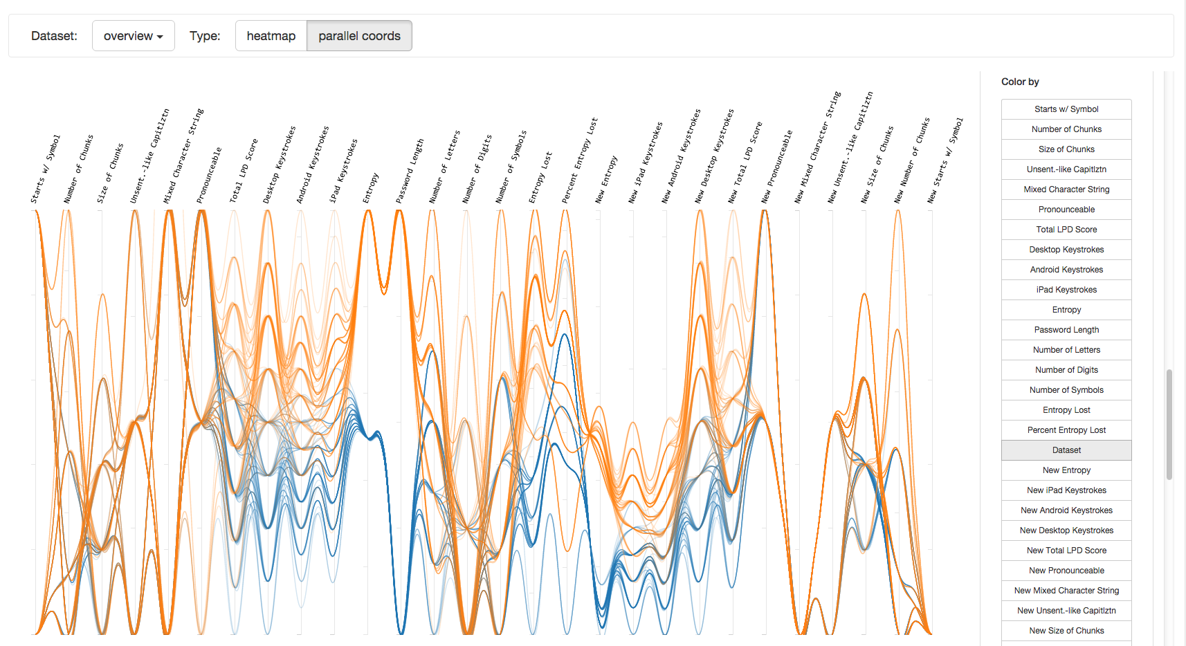

Slide 72
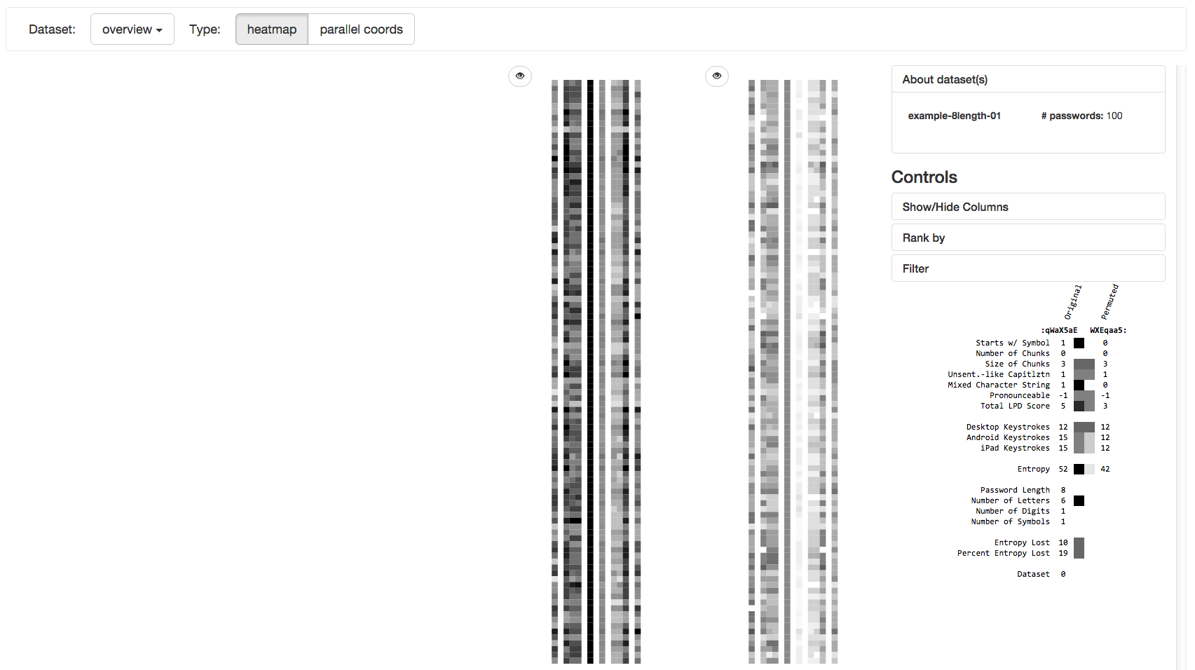

Slide 73
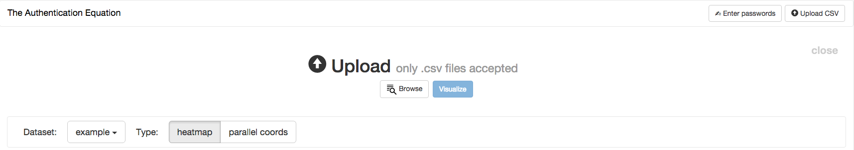
GUI improvements

Slide 74
Code restructuring
-------------- -----
--------
-----------------
-------------- -----
--------
-----------------
------
-------------- -----
--------
-----------------
-------------- -----
--------
-----------------
------
-------------- -----
--------
-----------------
-------------- -----
--------
-----------------
------
Modular design, reuse for other multivariate data

Slide 75
Identifying password metrics
Building the tool
Walkthrough
Lessons learned

Slide 76
3
Walkthrough

Slide 77
Identifying password metrics
Building the tool
Walkthrough
Lessons learned

Slide 78
4
Lessons
learned

Slide 79
Understand and communicate the encoding scheme of visualization

Slide 82
Understand constraints of specialized visualization tools

Slide 83
Future work
Expansion of security metrics
Expand into a generic multivariate data analysis tool
Client side calculation of password values

Slide 84
Thank you
Reach out
cathryn.ploehn@nist.gov
@cathrynploehn
The tool
github.com/usnistgov/DataVis

Slide 85
Questions?
Reach out
cathryn.ploehn@nist.gov
@cathrynploehn
The tool
github.com/usnistgov/DataVis

